Slide 1
VG Development – Development Process
Interactive Media
Unit 1

Slide 2
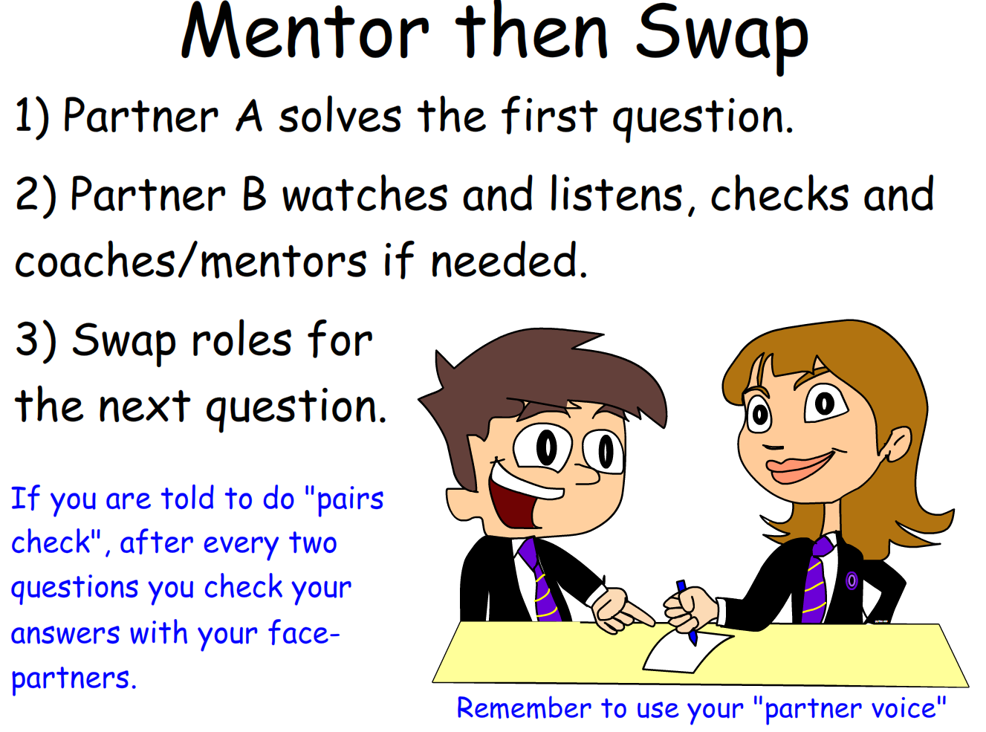
Starter – 5 Minutes
Log in and fill your answers into your worksheet.
Without speaking to a client in person, how would you know what they want from a product?
What steps could you take in order to ensure you get every part of a product completed in time?

Slide 3

Learning Outcomes
Aspire to ……
 | Explain how the project lifecycle is used to effectively develop an interactive media product.
Challenge to……
 | Describe how to analyse the client’s requirements.
 | Understand the steps taken to produce a VG.

Slide 4
Producing a VG
Most production companies follow the project lifecycle when producing an Interactive Media product.
This is exactly the same when producing video games.
Different iterations of the process will be used by different groups, however, to ensure you keep up the plan during the project, you will follow this process.

Slide 5
Project Lifecycle
The project lifecycle follows four main phases:
Initiation
Planning
Execution
Evaluation
These phases are followed in order, however if issues are found in a phase, you can go back a phase to resolve the issue.

Slide 6
Initiation Phase
The primary purpose of the initiation phase is to gain information about the project.
Some information will have been given by the client, so it is the development team’s (your) job to gain enough information to create the project.
This phase is spent gathering the necessary information required to plan the project, e.g. how much time is given, hardware requirements, target audience etc.

Slide 7
Planning Phase
As the name suggests, the purpose of the planning phase is to get the planning for the project done.
Not only does this phase cover the timings of the project, it also covers the general idea for the project and expanding on the details from the initiation phase.
The developers should be able to look through all of the planning materials and make the product from the documents.

Slide 8
Execution Phase
The execution phase is spent producing the actual product.
The planning materials are used to determine what is being produced and when.
The product must meet the requirements set by the client otherwise the project would be considered a failure.
Any supporting documents are made during this phase, e.g. instructions.

Slide 9
Evaluation Phase
The final phase, the evaluation phase, is used to check that the project has gone as intended.
The main focus is that all of the requirements are met by the client.
During this phase, the developers will communicate with the client to ensure everything is as it should be. If there is anything missing, the developers will need to return to the execution phase to fix it.
Whether the plan has been met isn’t as such an issue so long as the project has been completed within the given time frame.

Slide 10

Task 1 – Project Lifecycle
For each of the following tasks, explain which phase they would be best suited to and why.
Setting who will be on which task and when.
Creating the supporting documents.
Checking that all of the requirements have been met.
Deciding which colours will be used for the interface.
Challenge D

Slide 11
Production Techniques
Due to how broad VG development is, there are a lot of potential skills required to produce a high quality product.
The following slides cover only a small selection of those skills.
Although it may seem to be the more “fun” option of the various interactive media products, there is a lot of additional work that needs to be done and is often overlooked.

Slide 12
Production Techniques – Programming
One key element of the development process that is consistent throughout most development software is the requirement of programming elements.
These are used to get the majority of the game’s mechanics working as intended.
However, some of the skills required can be quite challenging to produce a high quality product.

Slide 13
Production Techniques – Asset Development
One overlooked skill is the collection and development of assets for use in the project.
Although there are some freely available assets such as textures and sprites, they won’t all fit for the project brief.
Creating assets can be done in various tools such as image manipulation tools, 3D-modelling software and audio-creation software.

Slide 14
Production Techniques – Breaking Down a Brief
To understand what actually needs to be made, the brief needs to be fully understood.
Breaking down a brief into the necessary detail allows the development team to understand what is required by the client. This also allows the development team to clarify information with the client.
For example: “The player’s score should increase when they score a goal”
How much should it increase by?
How do they score a goal?

Slide 15
Task 2 – Analysing a Brief
Read through and analyse the brief in the worksheet.
What could happen if you don’t have all of the necessary information?
How would this effect the overall project?
Explain why you need that additional information.
Note down what additional information is needed.
Challenge D

Slide 16
Plenary – Analysing an Amended Brief
Read through and analyse the new amended.
Would you be able to plan the product now? Explain your answer.
How else could you obtain this new information?
Is all of the information you need now there? What has been added?

Slide 17
Plenary – Amended Brief
Your client requires for you to produce a 2D platformer game for Android and iOS devices. iOS 9 upwards and Android KitKat onwards should be supported fully. The game will be sold for £0.99.
The game should allow the player character to move across the screen freely in a small predetermined level. There will be 20 levels. Information about the “maps” can be found in another document.
The ten playable characters will each have a unique colour scheme and special ability. Information about the player characters can be found in another document.

